Slide 1

Animal Magic
Veterinary Practice Management

Slide 2

Brief
A veterinary practice has approached you to build a web application to help them manage their animals and vets.
Vets look after MANY animals
Animals have a SINGLE vet
Owners can have MANY animals
Animals have a SINGLE owner
Animals & Vets can have MANY appointments
Notes:
PLANNING PROCESS
HELPED CLARIFY TASK

Slide 3
Brief
Functionality
Be able to assign or register Pets with Vets
CREATE – Pets, Vets, Owners & Appointments
READ – Vet, Pet & Owner records, Appointment details and notes.
UPDATE – Owners & Pet records, Vet Details, Appointment Notes
DELETE – Pets or Vets that leave the practice.
Notes:
THIS HELPED CLARIFY WHAT WAS REQUIRED FOR MVP

Slide 4
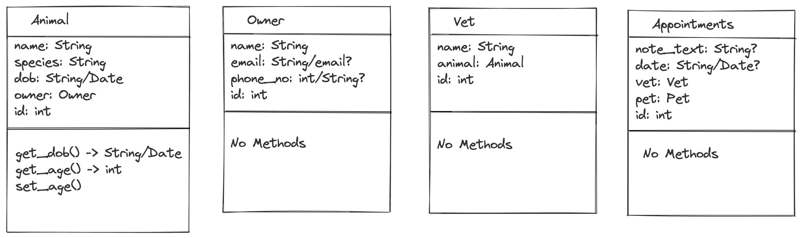
Class Diagrams
Notes:
SLIGHTLY USEFUL

Slide 5
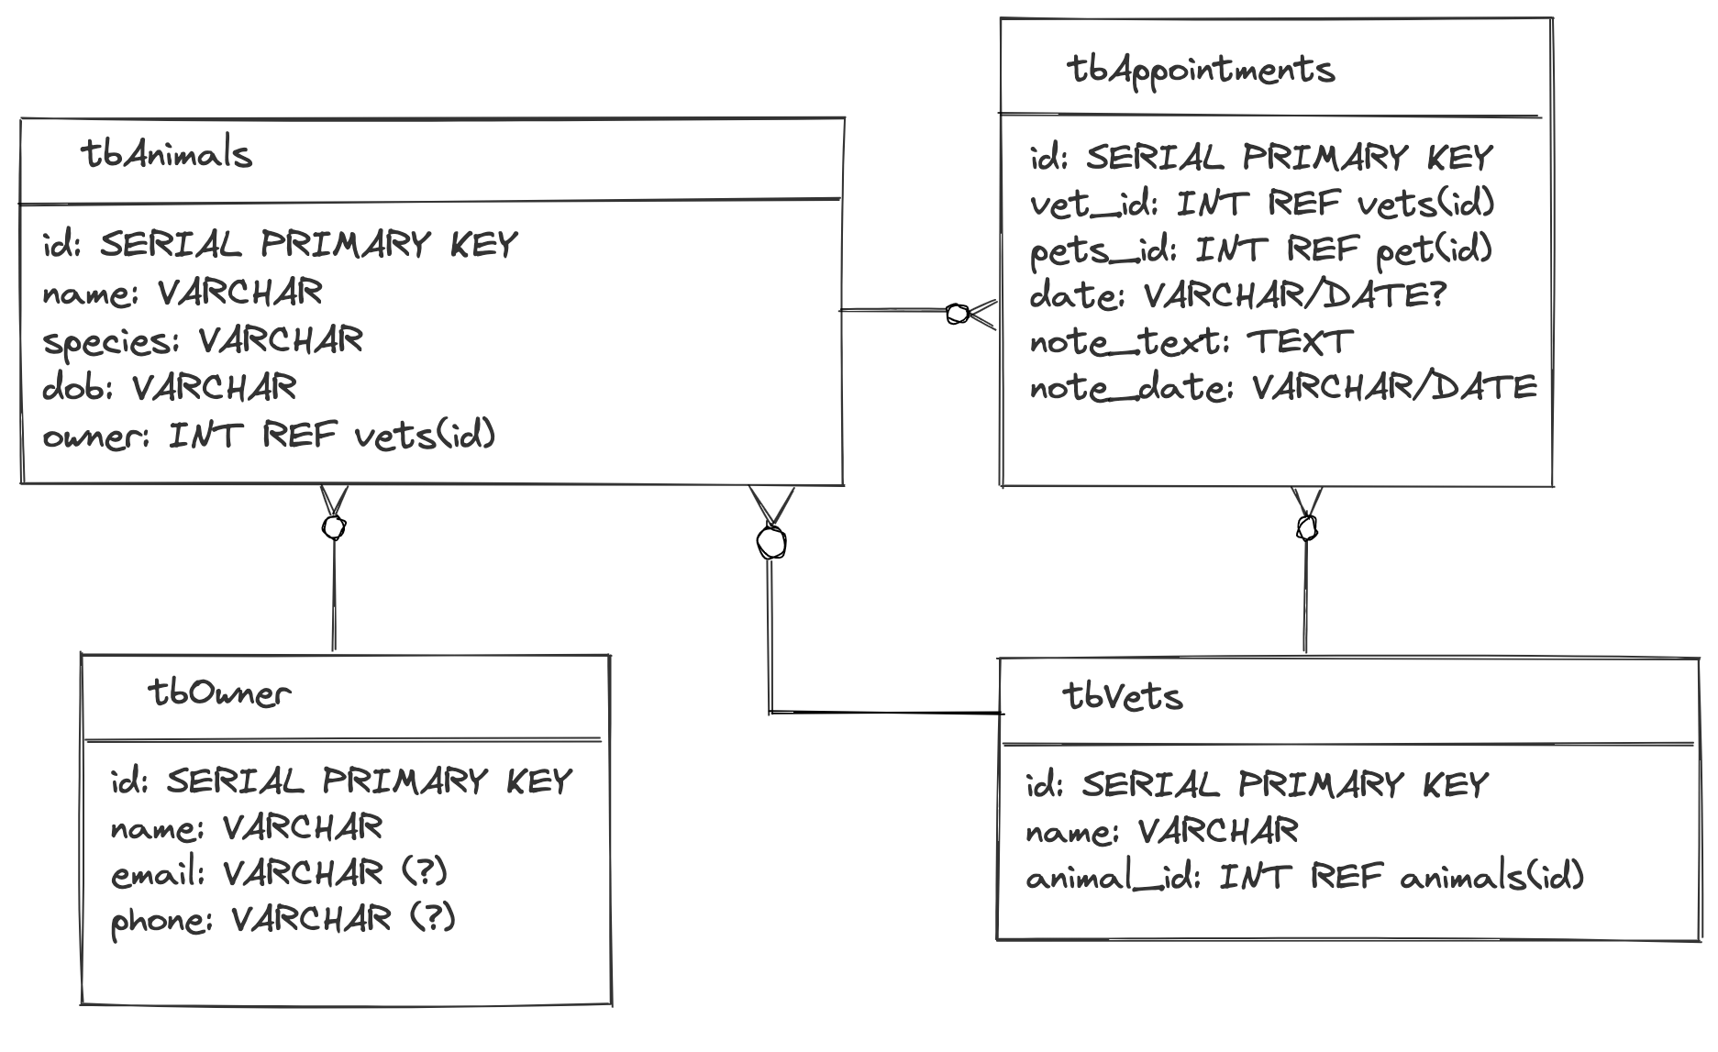
Table Diagram
Notes:
TABLES HELPED WITH RELATIONSHIPS
EASIER TO BE SURE OF OREDER TO
CREATE & DROP

Slide 6
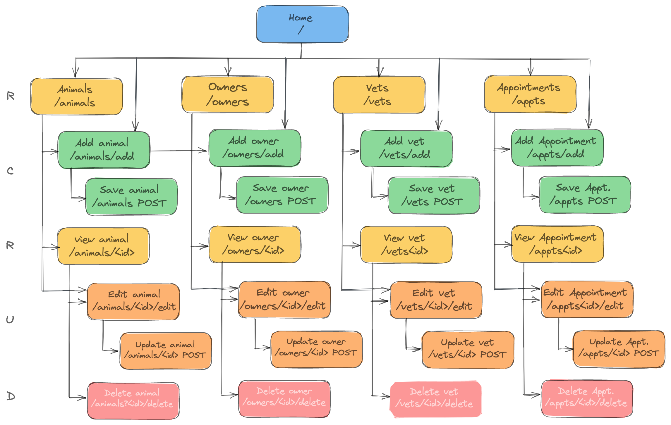
Site Map
Notes:
Helpful when coding
It made routes simple when head was in coding mode

Slide 7
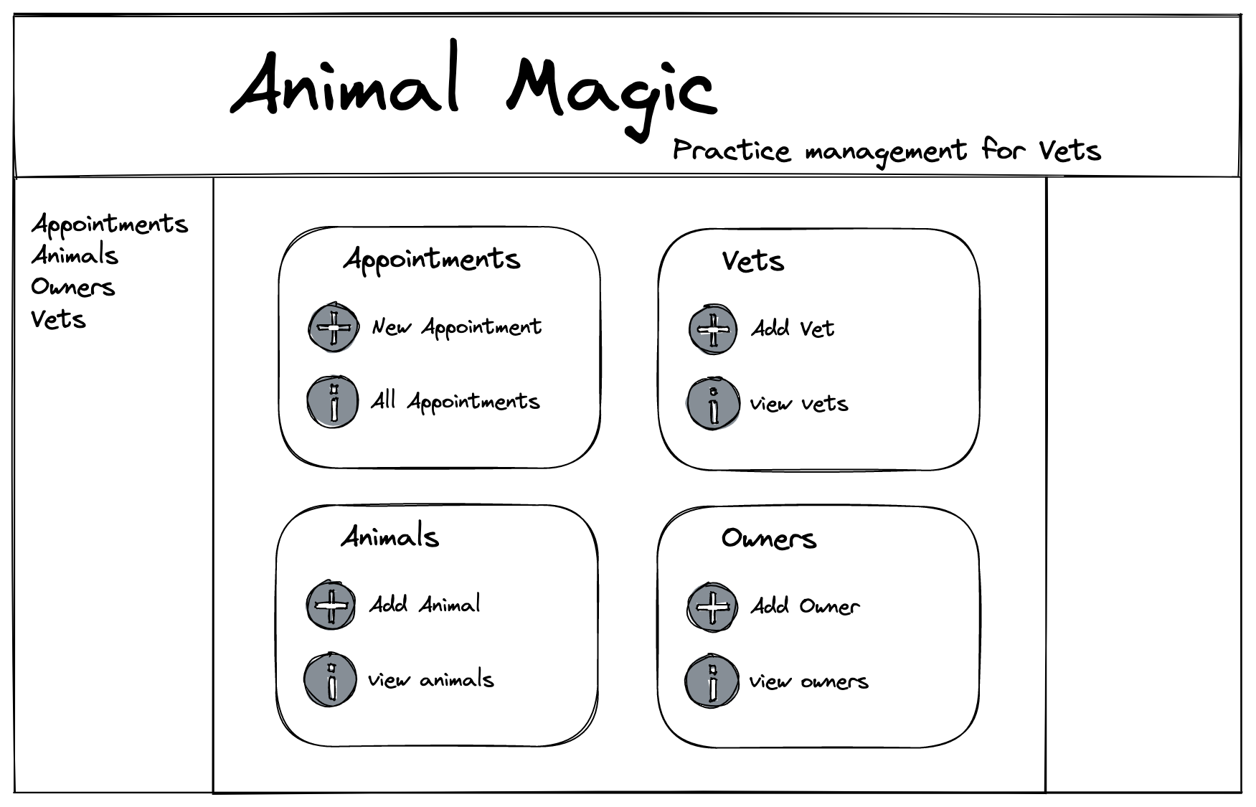
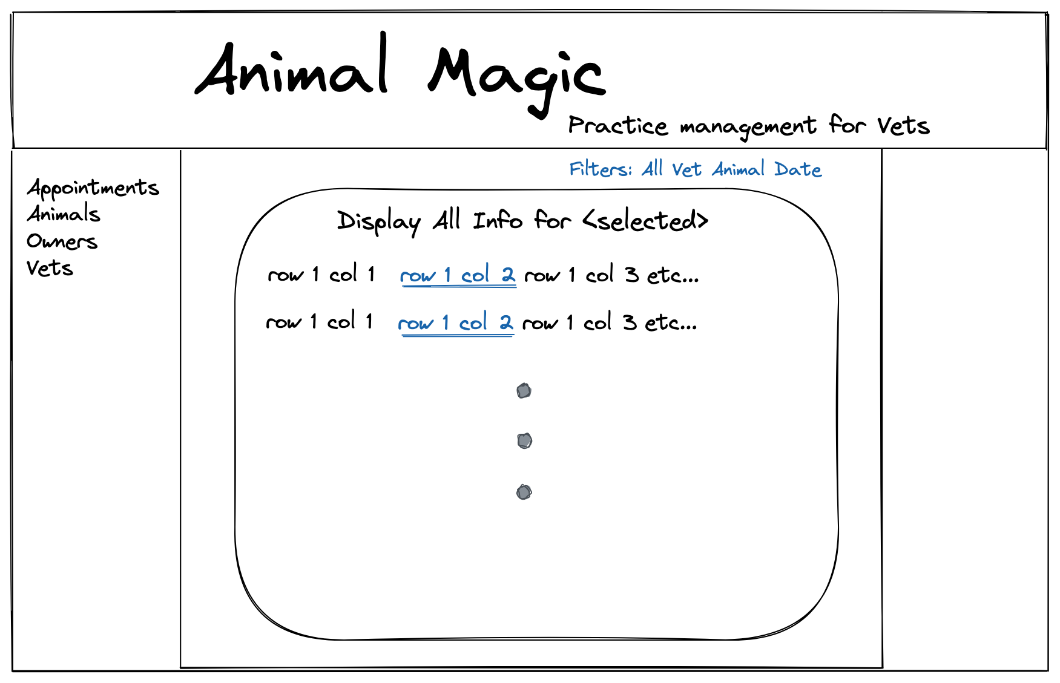
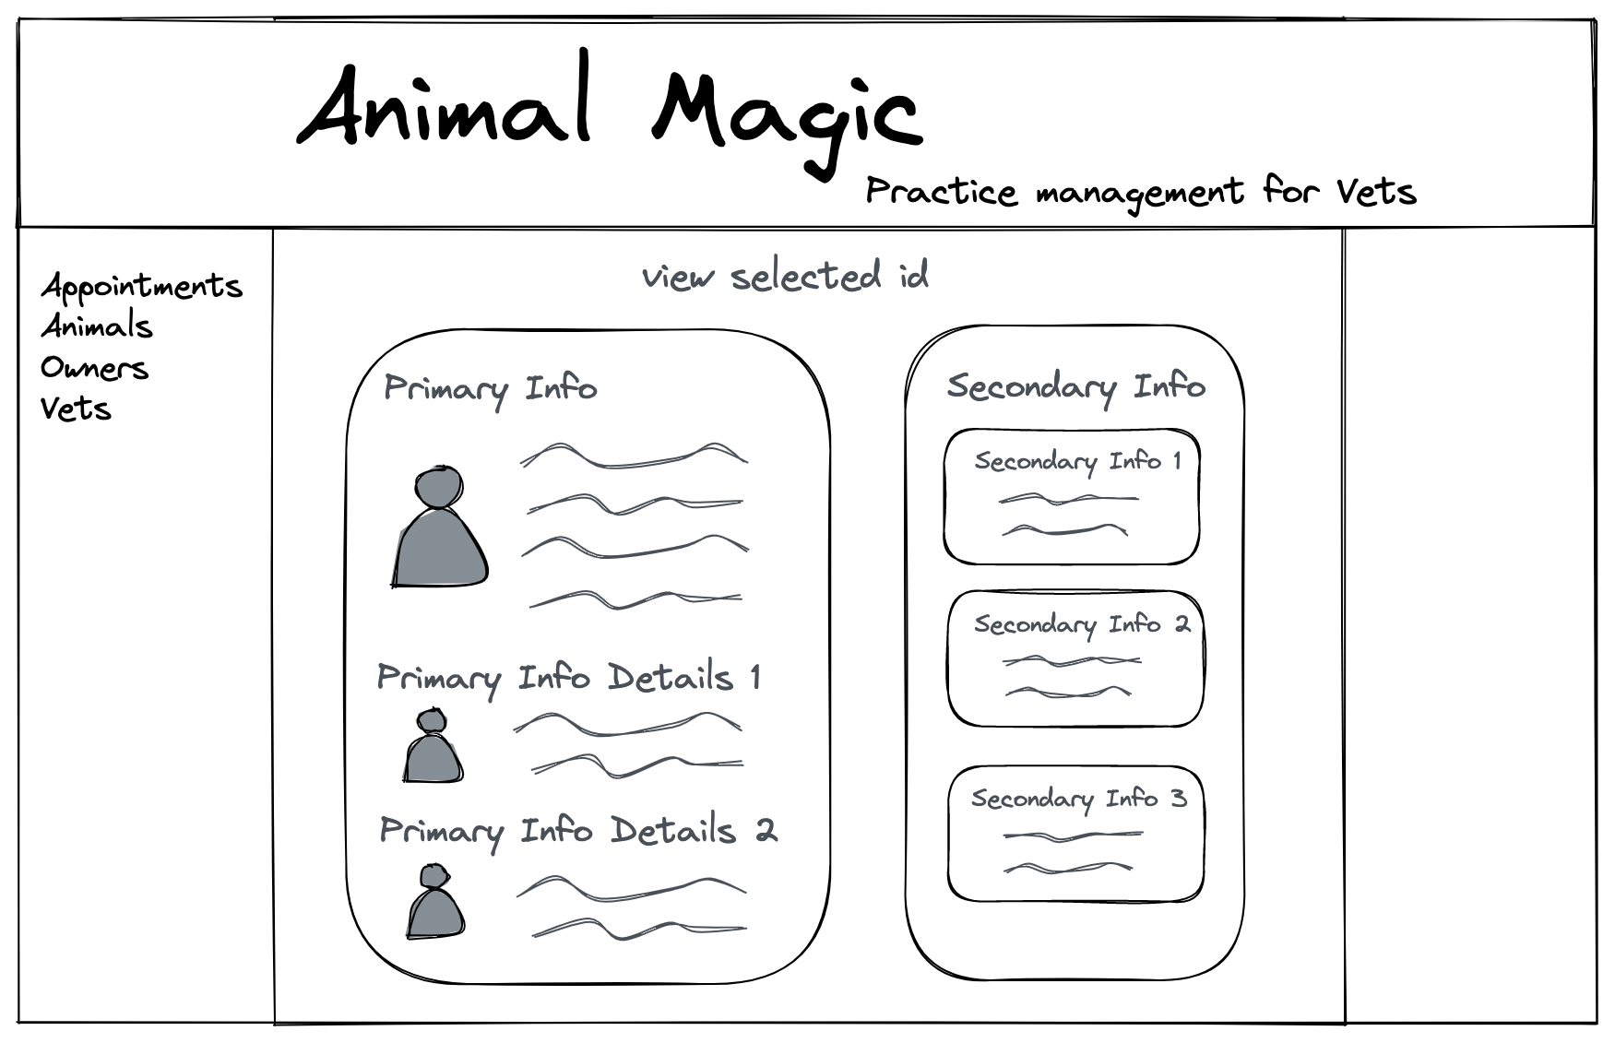
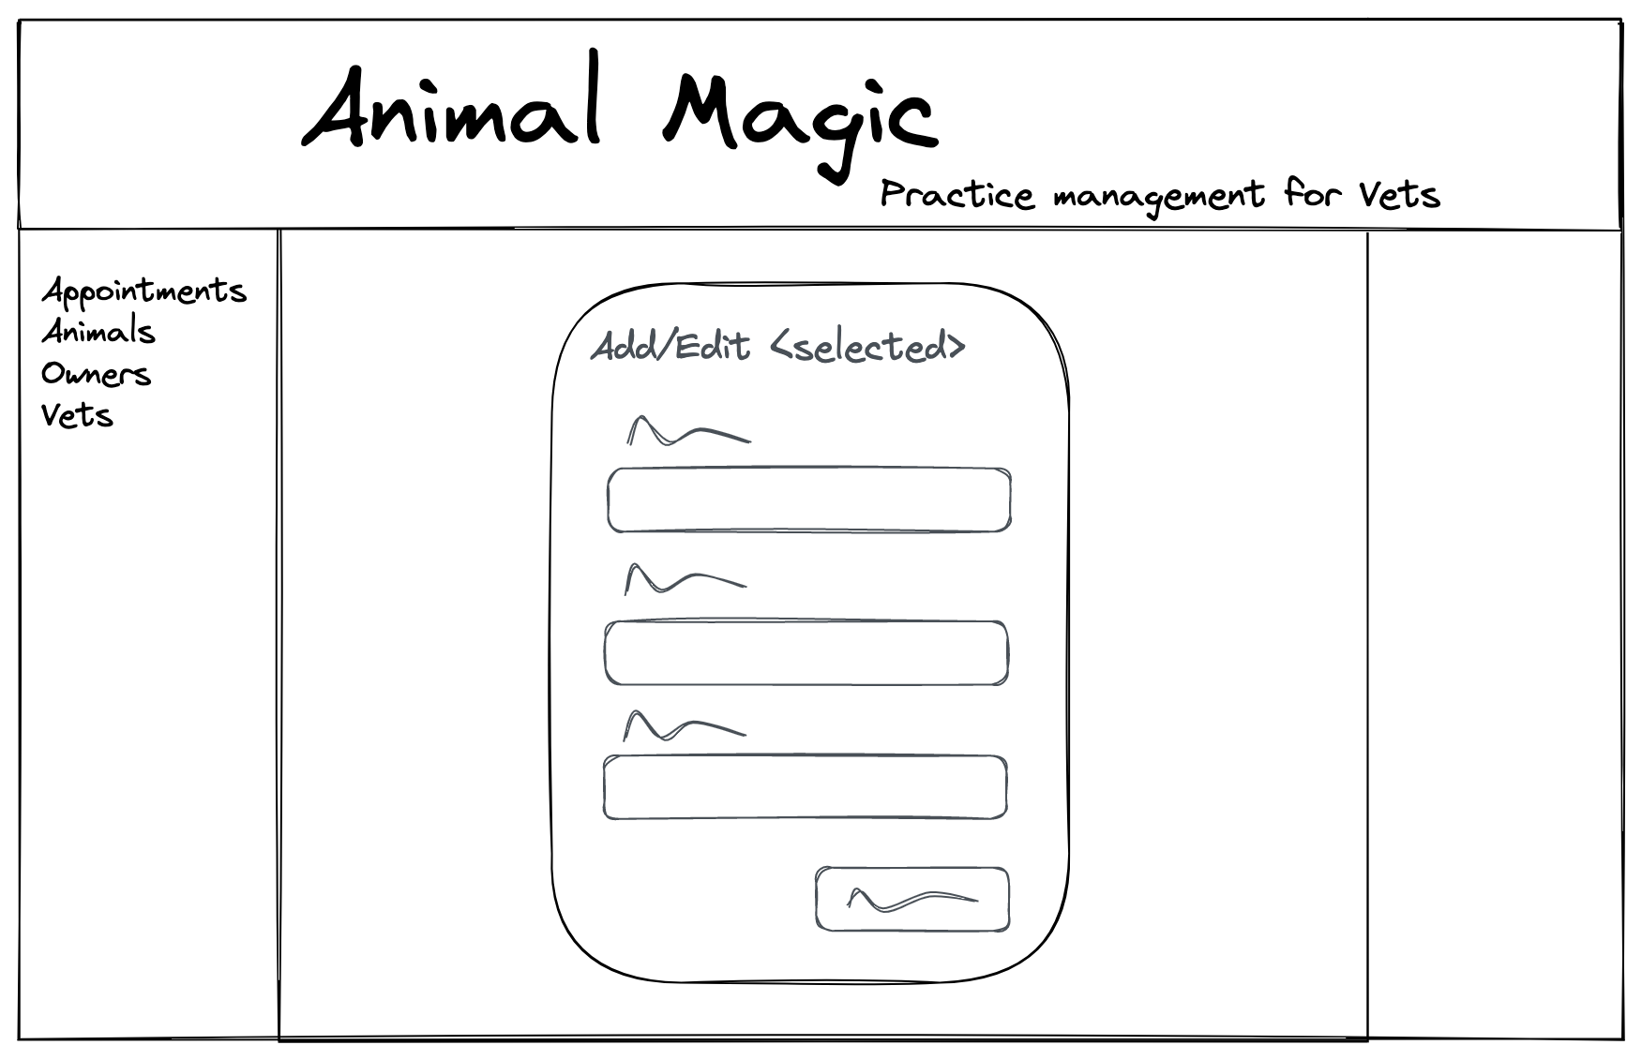
W i r e f r a m e s
Notes:
Who was the user
As much info on page without being too busy
Converstion with Clau
Technocrush on Excalidraw
Set out to replicate wireframes as closely as possible
Font - success
borders - leave for another time!

Slide 8
Demo time

Slide 9
Extension Ideas- Must, should, could, won’t
Add warning message for deleting (should) ->Javascript
Set vet for making appts so not editable(should)
Add confirm message for updates (Should) -> Javascript
Age or dob option? (should) could solve with dummy dob based on reg date & dob known bool
Add all appointments in aside on view selected page (should)
Add animals/owners/vet in second aside (should)
Make all fields required when adding new entries(should)
sort appointments by date, animal, vet, owner (should)
Add submenu items – add/edit/all (should)
Add pages to list results (could)
Add short note with option to expand (could)
Filter by in clinic – handle check in/out (could)
Check if owner exists when add new owner (could)
Media queries – collapsible menus etc (could)
Login page – different views for user type, ie Vet or Reception (could)
Billing? (Could)
Online booking (won’t)

Slide 10
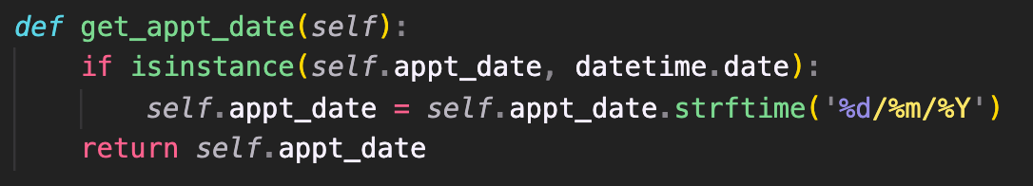
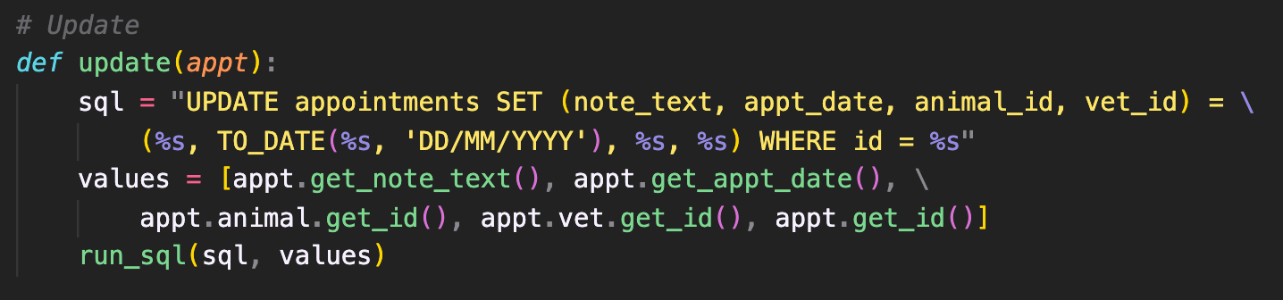
Favorite bit of code
Notes:
HANDLED the interface of human input and SQL STRICTNESS
SQL happy with strings
Python happy with string
DATE in SQL for sortabilty

Slide 11




Learning Objectives
Get more comfortable:
Experimenting with CSS & HTML
Working with Routes
Using SQL
Notes:
CSS - Planning, Organisation & Containers
Kept in mind objectives over building fancy app

